Slide 1
Introduction to Deep Learning

Slide 2
Content
Introduction to Deep Learning
Theory
Introduction to Machine Learning & Deep Learning
Fundamentals of Machine Learning & Deep Learning
Feedforward Neural Network

Slide 3
Deep Learning
Introduction

Slide 4
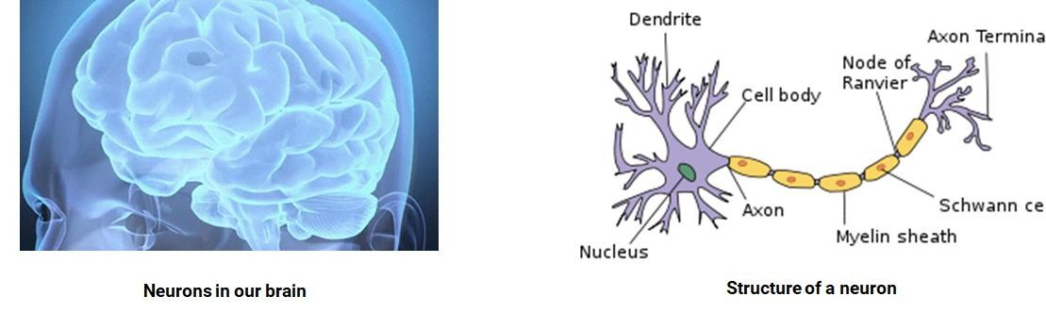
Human Brain
Our brain is the most complex thing in our known universe.
It consists of hundreds of billions of neurons. Each neuron is connected to each other.
All neurons fire and communicate with electrical signals to each other when we think.
Source： GIPHY, Wikipedia

Slide 5
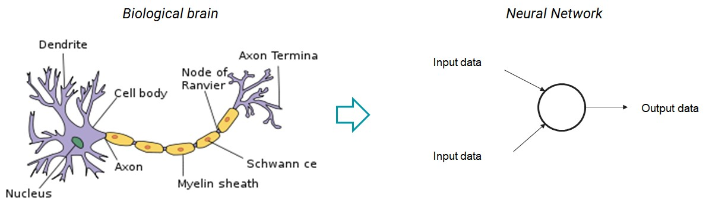
Deep Learning - An algorithm that mimics how the brain works
Neural networks mimic how our brain works
Neural networks consist of perceptrons, which replicate the role of neurons in the cyber world.
Source： Wikipedia

Slide 6
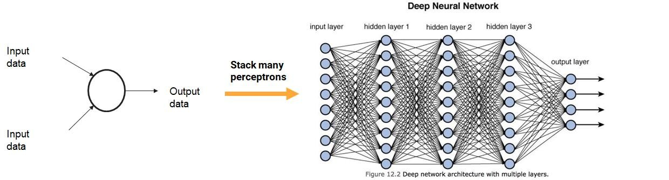
Deep Learning - An algorithm that mimics how the brain works
We stack many layers of perceptrons together to form a deep neural network.
We can think of the deep neural network as a replica of the human brain.
Deep Learning means the use of deep neural network to learn.
Source： Wikipedia, https://towardsdatascience.com/training-deep-neural-networks-9fdb1964b964

Slide 7
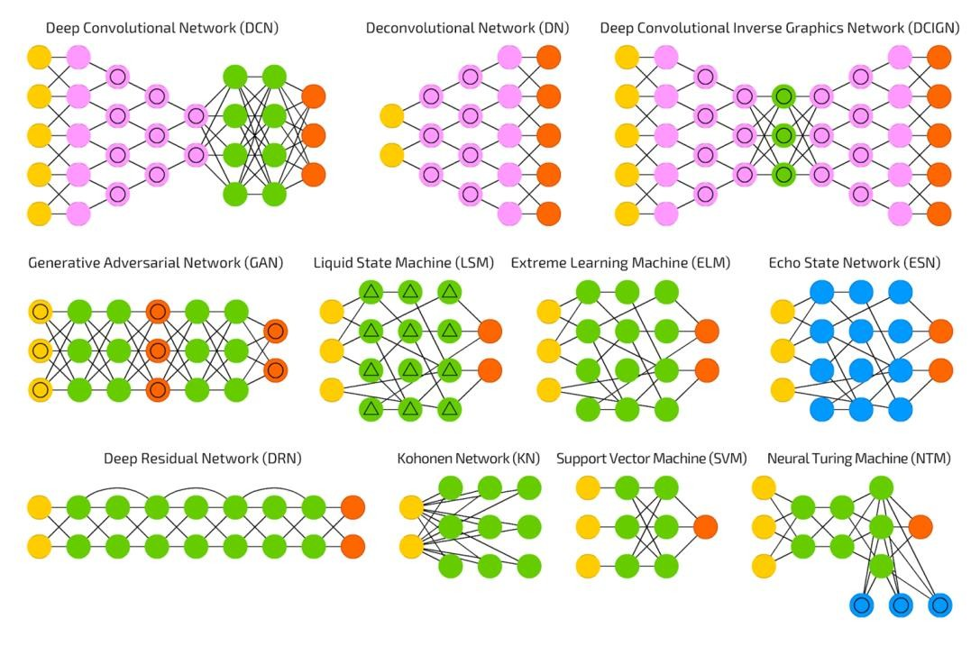
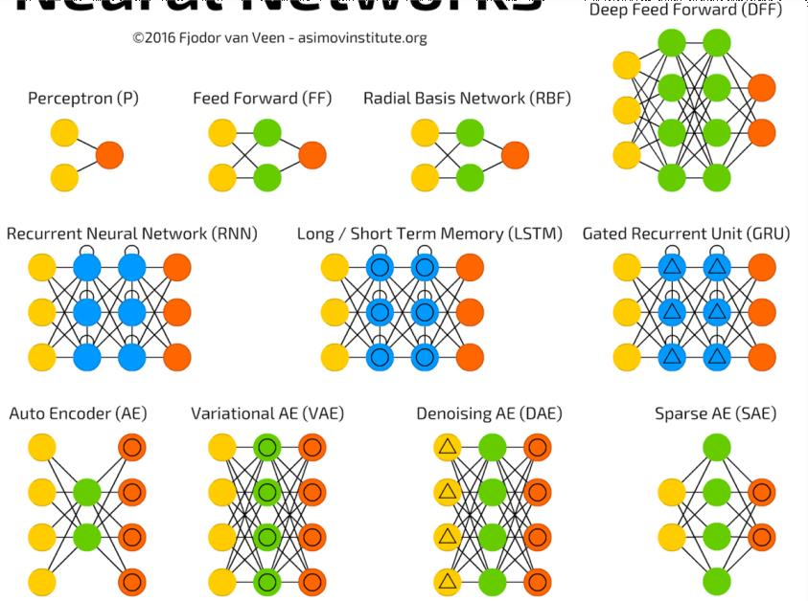
Deep Learning
Different type of neural network architectures
Image source: http://www.asimovinstitute.org/neural-network-zoo/

Slide 8
Why use Deep Learning?
Works tremendously well with more data
Automatic feature extraction in deep learning
text
images (raw pixels)
sounds tracks
Etc
Able to learn non-linear relationships of the dataset

Slide 9
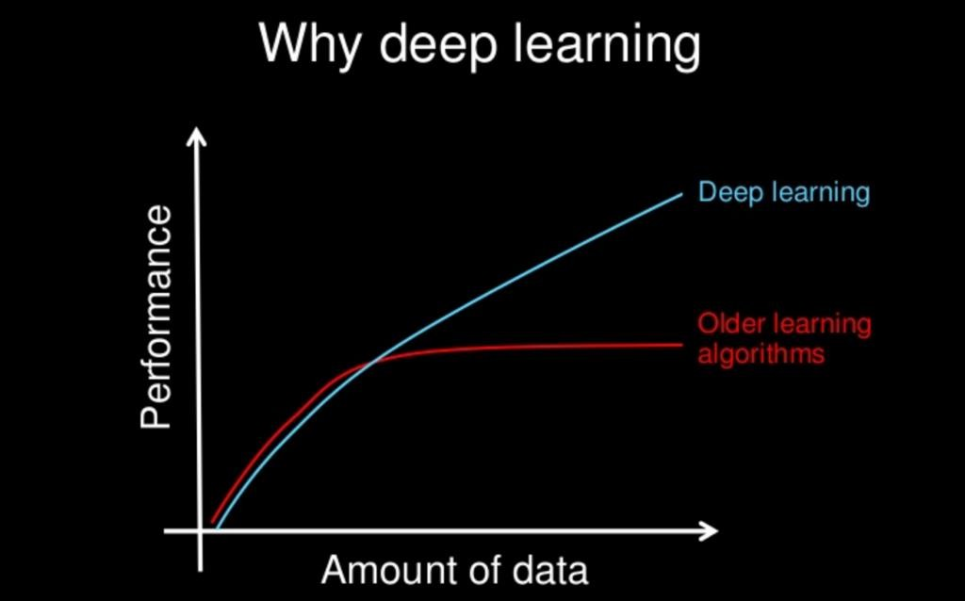
Why use Deep Learning?
Deep neural networks improve tremendously when trained on more data.

Slide 10
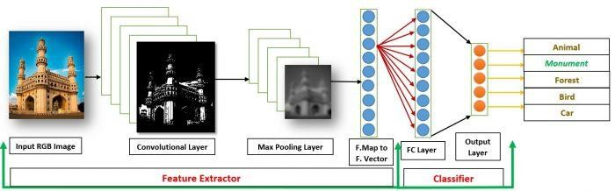
Why use Deep Learning?
Automatic feature extraction
Images
Colors
Edges
Texture
Outline of the object
Text Data
Keywords
Numbers
Length of the text
Speech
Pitch
Pause
Use of words

Slide 11

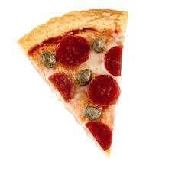

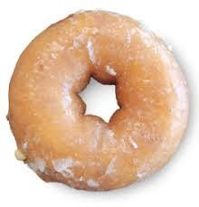
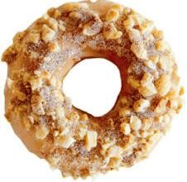


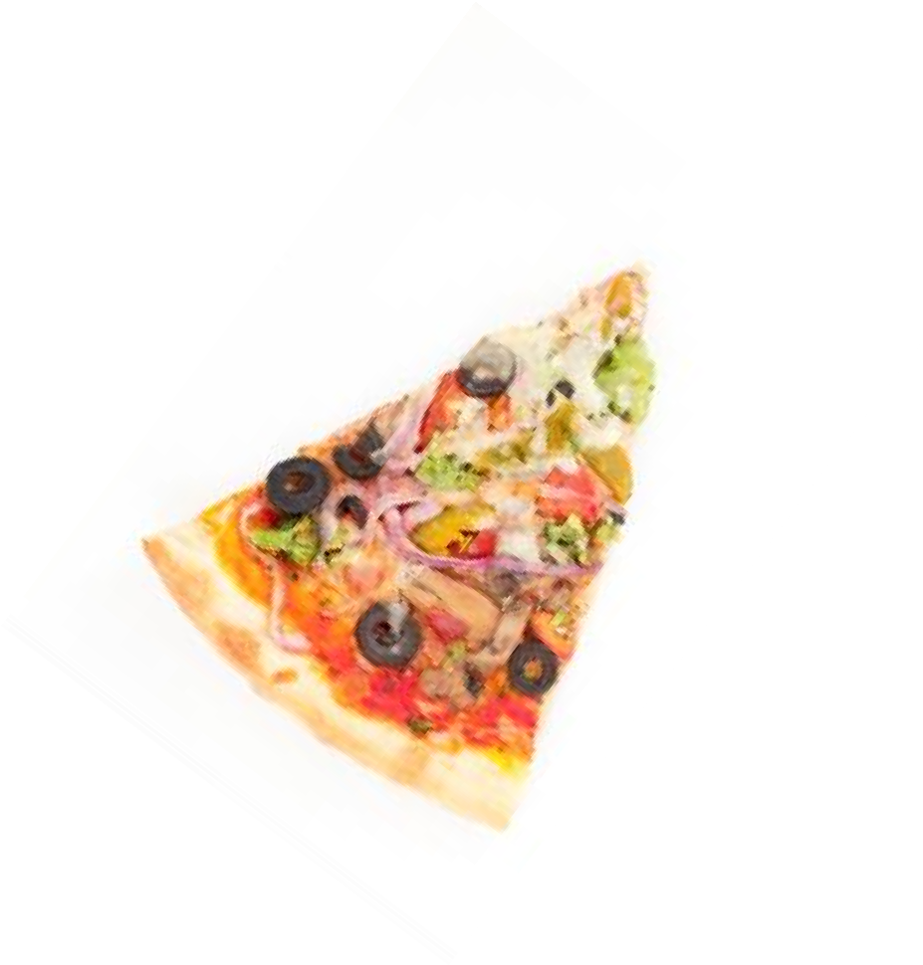
Linear
Why use Deep Learning?
Non-linear
Real world problems are complex
Neural networks have the ability to learn non-linear and complex relationships
Handson with:
https://playground.tensorflow.org/

Slide 12
Deep Learning
How it works in general?

Slide 13
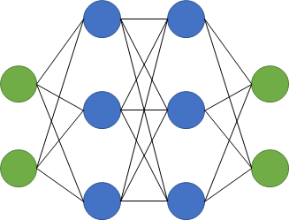

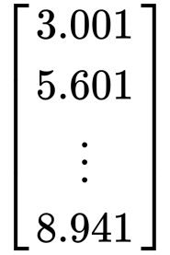
How deep neural network works?
Deep Learning Architecture
0.98 Dog
0.02 Cat

Slide 14

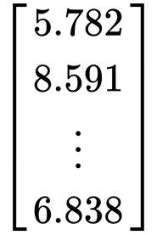
How deep neural network works?
Deep Learning Architecture
0.4 Dog
0.6 Cat

Slide 15
Feedforward Neural Network
The simplest neural network

Slide 16
Training Steps
1. Initialize parameters (weights and biases)
Training loop:
Forward propagation
Get predictions
Compute loss (Find the difference between labels and predictions)
Backward propagation
Compute gradient of loss
Update parameters
Repeat until neural network converges

Slide 17
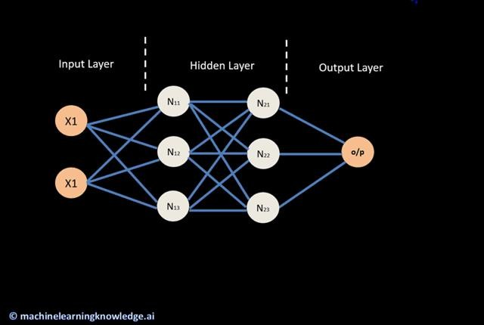
Training Steps

Slide 18
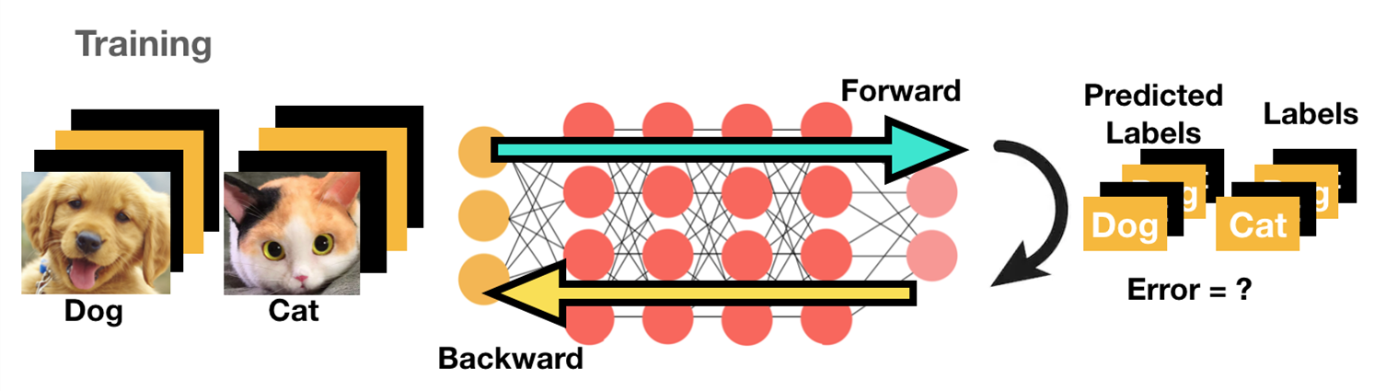
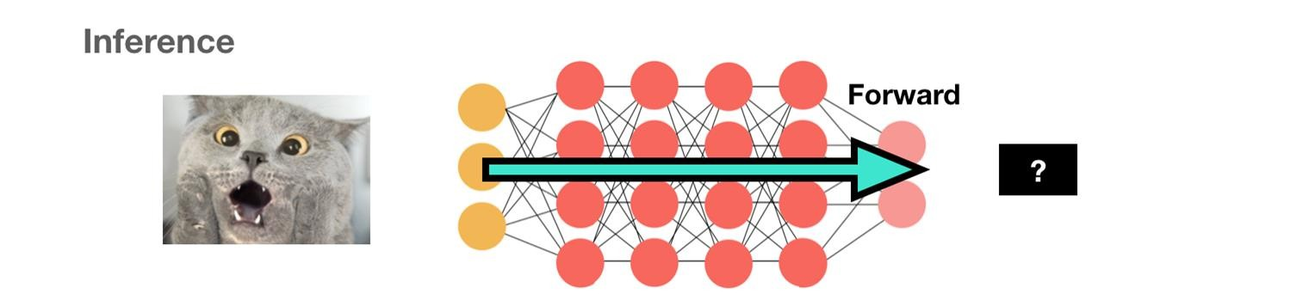
2 Phases of Neural Network
Classification scenario illustrated for easy understanding

Slide 19
Training a neural network
Forward Propagation

Slide 20
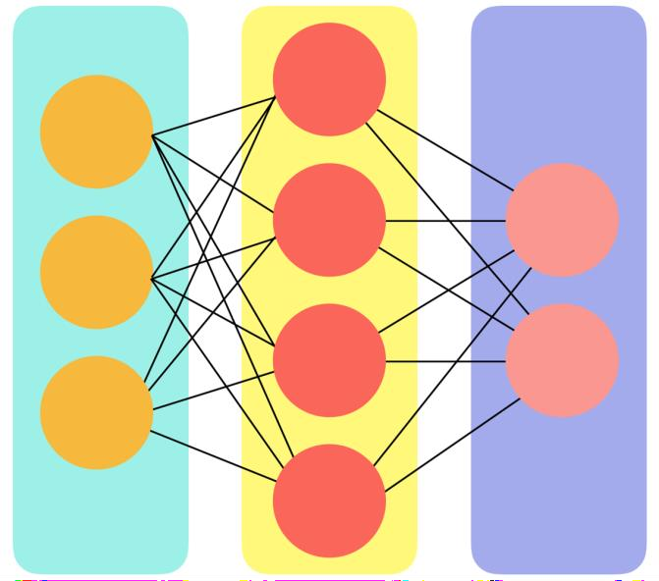
Feedforward Neural Network
Most typical form of neural networks model
Each node is fully connected to all nodes of next layer
Final output may be
real-valued output (regression)
a set of probabilities (classification)
Fully connected multi-layer feed-forward network topology

Slide 21
Neural Network Topology
Input Layer: load and store raw input data
Hidden Layer: contained learned information of the raw training data
Output Layer: get prediction from the network
Input Layer
Hidden Layer
Output Layer

Slide 22
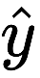
Forward Propagation
X₁
L1N₁
L2N₁
X₂
L1N₂
L2N₂

Slide 23
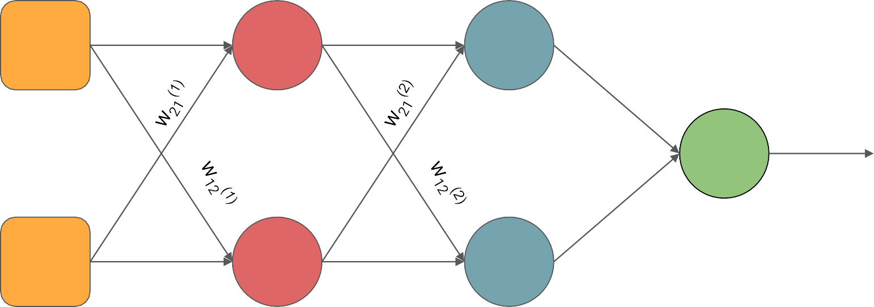
Parameters initialization
W
(1
= Weight from node 1 of layer 1 to node 1 of next layer
)
11
w
11
(1)
w
11
(2)
X₁
L N
L₂N₁
1
1
w
(3)
11
_{w21}(3)
w
22
(1)
w
22
(2)
X₂
L N
L N
1
2
2
2
_{b}(1
_{b}(2)
_{b}(3)
)

Slide 24
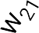
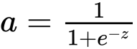
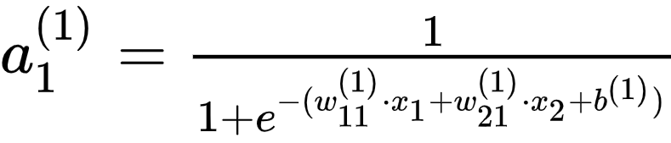
Forward Propagation
w
(1)
_{a} (1)
Consider L1N1,
11
1
X₁
L₁N₁
_{z} (1) _{= w}
(1) _{* x + b}(1)
⁽¹⁾ * x + w
1 11 1 21 2
Activate z with sigmoid activation
Output of L1N₁, a₁⁽¹⁾
X₂
_{b}(1)
Why activation?

Slide 25
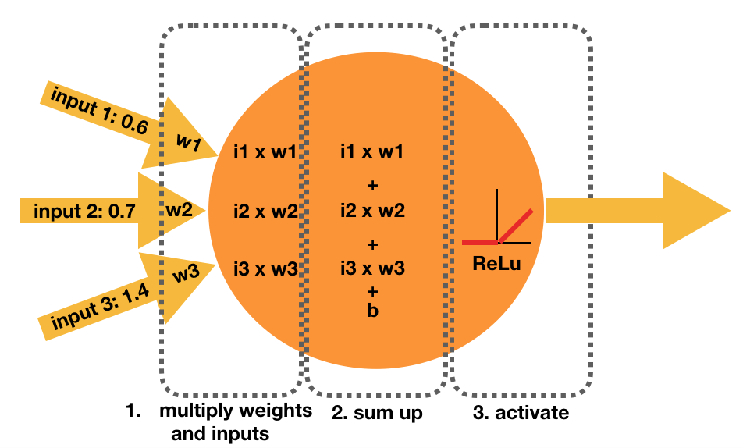
Perceptron / Neuron
Each neuron has
Incoming weights and a bias value
An activation function

Slide 26
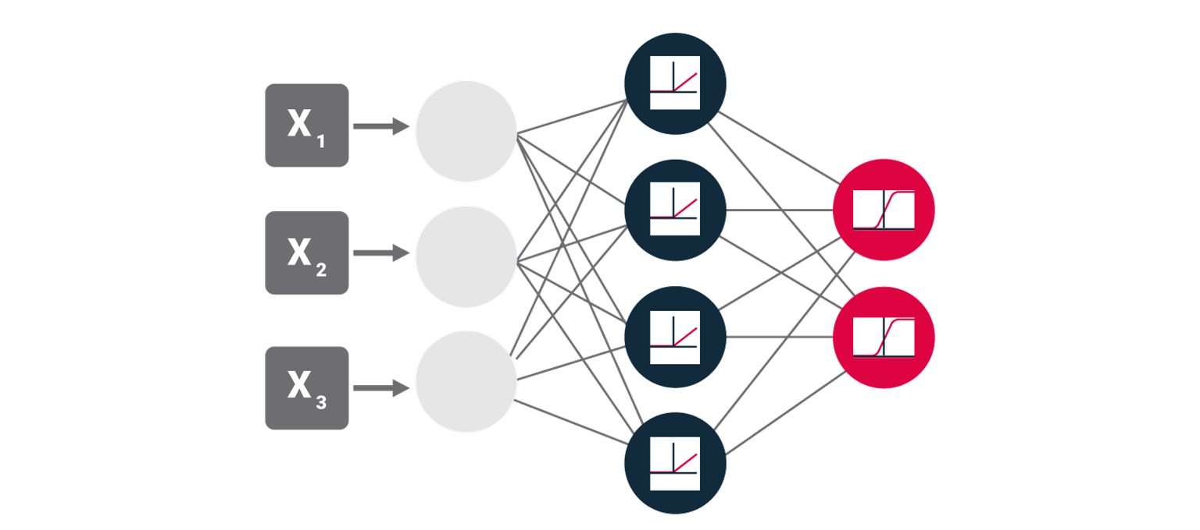
Activation Function
Transforms the combination of inputs, weights, and biases x₁ x1
The transformed value is the input of next node
Adds
non-linearity
to the network (allows networks to learn non-linear functions)

Slide 27
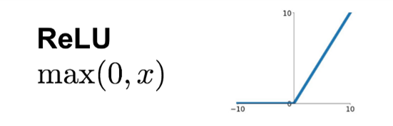
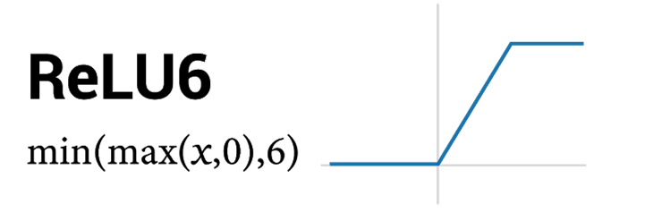
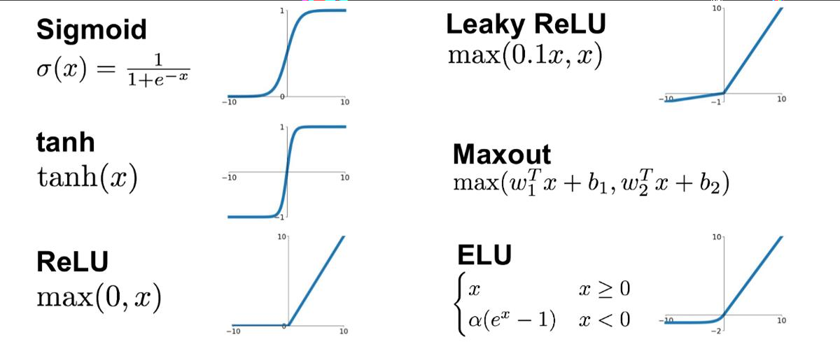
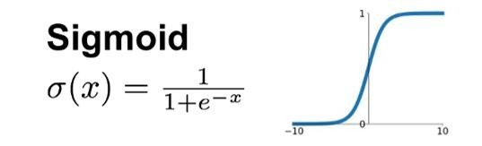
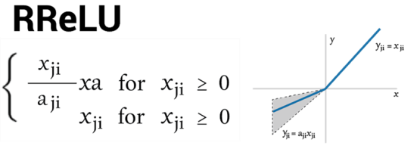
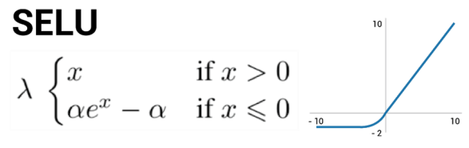
Activation Function
Hidden Layer
Activation Functions

Slide 28
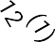
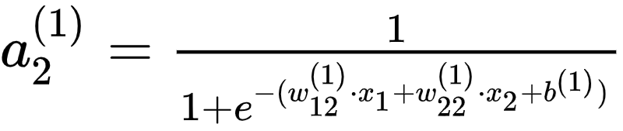
Forward Propagation
Consider L1N₂
(1) _{* x + w} (1) _{* x + b}(1) ^{z}2^{(1) = w}12 1 22 2
Activate z with sigmoid activation
X₁
Output of L1N₂, a₁⁽¹⁾
w
(1)
_{a} (1)
22
2
X₂
L1N₂
_{b}(1)

Slide 29
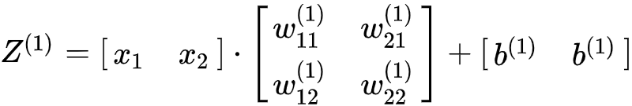
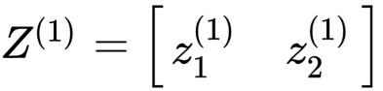
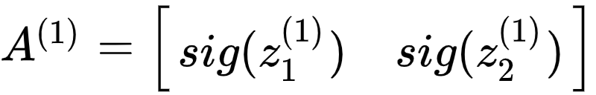
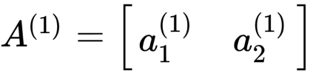
Forward Propagation
Recall,
_{z1}(1) _{= w}
⁽¹⁾ * x + w
(1) _{* x + b}(1)
w
(1)
_{a} (1)
_{a} (1)
11
1 21
, (1)
2
11
1
1
= Sigmoid(z ₁ )
X₁
L1N₁
_{z2}(1) _{= w}
⁽¹⁾ * x + w
(1) _{* x + b}(1)
12 1 22
1
a₂⁽¹⁾ = Sigmoid(z₂⁽¹⁾)
We can represent it via matrices A = X.W^{T} + b
^{w}22
(1)
_{a2}(1)
X₂
L1N₂
_{b}(1)

Slide 30
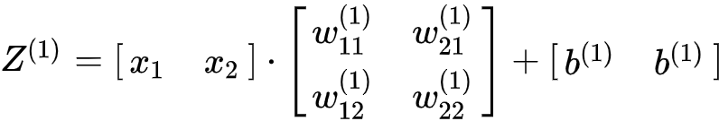
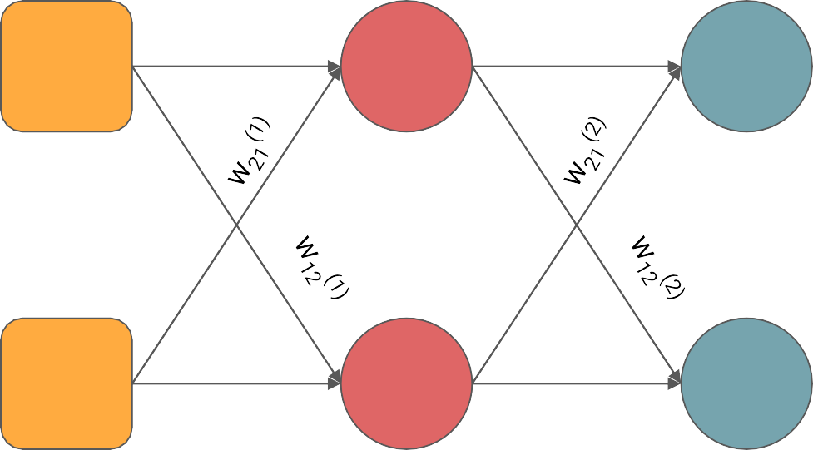
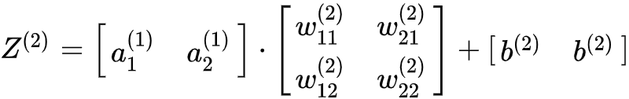
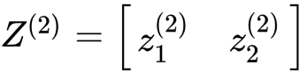
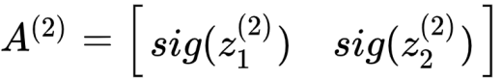
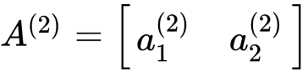
Forward Propagation
_{a1}(1)
w
11
(1)
w
11
(2)
X₁
L1N₁
L2N₁
How to get A2?
_{a2}(1)
^{w}22
(1)
^{w}22
(2)
X₂
L1N₂
L2N₂
_{b}(1
_{b}(2)
)

Slide 31
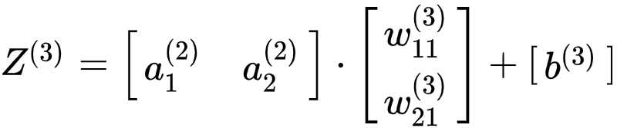

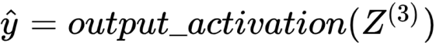
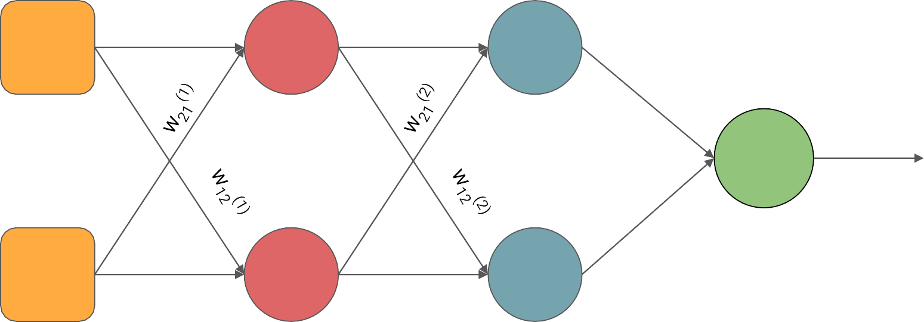
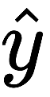
Forward Propagation
_{a1}(1)
_{a1}(2)
w
11
(1)
w
11
(2)
X₁
L1N₁
L2N₁
Task dependent
w
11
(3)
L3N₁
_{a2}(1)
_{a2}(2)
^{w}21
(3)
^{w}22
(1)
^{w}22
(2)
X₂
L1N₂
L2N₂
_{b}(1
_{b}(2
_{b}(3)
)
)

Slide 32
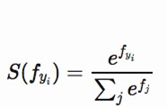
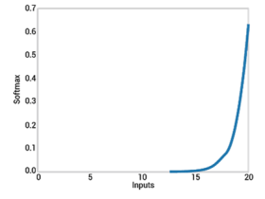
Activation Function
Output Layer
Activation Functions
Binary Classification
Binary / Multi-class
Classification
Softmax
Softmax is a generalization of the sigmoid function.

Slide 33
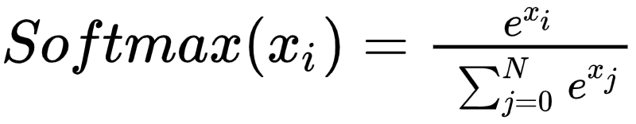







Softmax Activation
Turn array of numbers into probability
3
20.1
20.1/22.83
Input 1
e
0.8804
1
2.72
2.72/22.83
Input 2
e
0.1191
-5
0.01
0.01/22.83
Input 3
e
0.0004
22.83

Slide 34
Training a neural network
Loss Functions

Slide 35
Cost Function
Model learns by minimizing a cost function to find a set of parameters which represent the data
A cost function is a measure of "how good" a neural network did with respect to its given training sample and the expected output
Cross Entropy (binary)
Multi-class Cross Entropy
Negative Log Likelihood
Hinge
Squared Hinge
Classification
Mean Squared Error Loss
Mean Absolute Error Loss
Mean Squared Log Error Loss
Mean Percentage Error Loss
Poisson
L1
L2
Regression
Reconstruction Cross Entropy
Cosine Proximity
KL Divergence
Others

Slide 36







Overall Learning Framework
Given , where n = index number of data set, let say we have 3 training data, and each data has 3 features. We want to find the total loss.
Neural Networks
𝛳

Slide 37







Overall Learning Framework
If we have N data points, the loss can be expressed as
Neural Networks
𝛳

Slide 38






Overall Learning Framework
Network for regression output
Mean Square Error (MSE)
Hidden layer
MSE
Label
Where:
N : number of data points
: predicted value
: actual value (label)
Loss

Slide 39


Overall Learning Framework
Network for binary classification
Binary Cross Entropy (BCE)
Hidden layer
Sigmoid
BCE
Label
Where:
N : number of data points
: predicted value
: actual value (label)
Loss

Slide 40






Overall Learning Framework
Network for multi-class classification
Hidden layer
Cross Entropy Loss
Cross Entropy
Label
Where:
N : number of data points M : number of class
: predicted value
: actual value (label) s : softmax function
Loss

Slide 41

Example
Example, output from network
is [4, 64, 12]
4
Softmax
0.05
64
0.8
12
0.15

Slide 42

Example
Assume the actual label is 2, so we have our one hot encoded as [0, 1, 0]
0.05
0
= -(0*log(0.05) + 1*log(0.8) + 0*log(0.15))
= 0.223
0.80
1
0.15
0

Slide 43
Example
Assume the actual label is 1, so we have our one hot encoded as [1, 0, 0]
0.05
1
0
0
= -(1*log(0.05) + 0*log(0.8) + 0*log(0.15))
= 3.0
0.80
0.15

Slide 44


Training of Neural Network
What is the goal of training?
Adjust the weights and biases to achieve a set with the smallest error, by optimizing (minimize) the loss function.
For example in Linear Regression,
ŷ = Wx + B
Goal: Find good values for W and B such that the difference between points and line is minimized

Slide 45
Training a neural network
Backpropagation

Slide 46

Forward Propagation
Transmit input data from left to right, passing through certain activated neurons in between and generate predicted value

Slide 47

Back Propagation
“Backward propagation of errors” - To minimize the error by changing the weights of the networks

Slide 48

Gradient Descent
How to find the best set of parameters?
High loss
To update weights, we need to find the gradient
Loss
Low loss
Parameters with lowest loss
Source：https://www.kaggle.com/abdalimran/intuition-of-gradient-descent-for-machine-learning
Parameters

Slide 49



Gradient Descent
Learning rate
New weight
Old weight
Delta
If delta > 0, increase in weight increases error, then new weight should be smaller.
If delta < 0, increase in weight decreases error, then new weight should be greater.
If delta = 0, no more update is needed.

Slide 50










Gradient Descent
Network
parameters
Compute gradient of loss
Compute gradient of loss
...
Initialize parameters
Millions of parameters in
neural network
Long list of weights and bias to update
How to update them
effectively?

Slide 51




Chain Rule
Small changes in x will cause small changes y and eventually
causes small changes in z
To find how z changes w.r.t x,

Slide 52








Chain Rule
Case 2
Small changes in s will cause small changes x & y and eventually
causes small changes in z
To find how z changes w.r.t s,

Slide 53


Backpropagation - Backward Pass
How much weights w should change in
order to reduce Loss?

Slide 54

Consider a Multilayer Single Neuron NN
_{f}(3)_{(z}(3)_{)=a}(3) _{f}(2)_{(z}(2)_{)=a}(2
_{z}(3)
_{f}(1)_{(z}(1)_{)=a}(1)
_{z}(1)
_{f}(0)_{(z}(0)_{)=a}(0)
_{z}(0)
)
_{z}(2)
Loss
(pred - actual)²
_{w}(3)
_{w}(2)
_{w}(1)
_{w}(0)
_{N}(3) _{N}(2)
_{N}(1)
_{N}(0)
(Output)

Slide 55
Consider a Multilayer Single Neuron NN
_{f}(1)_{(z}(1)_{)=a}(1) _{f}(2)_{(z}(2)_{)=a}(2
_{z}(1)
_{f}(3)_{(z}(3)_{)=a}(3)
_{z}(3)
_{f}(4)_{(z}(4)_{)=a}(4)
_{z}(4)
)
_{z}(2)
Loss
(pred - actual)²
_{w}(1)
_{w}(2)
_{w}(3)
_{w}(4)
_{N}(1) _{N}(2)
_{N}(3)
_{N}(4)
(Output)

Slide 56
Training a neural network
Optimizers

Slide 57

Gradient Descent
Training of deep learning algorithms minimize the cost function by going through a series of steps to convergence ( an acceptable minimum)

Slide 58
Gradient Descent
Learning rate
New weight
Old weight
Delta
If delta > 0, increase in weight increases error, then new weight should be smaller.
If delta < 0, increase in weight decreases error, then new weight should be greater.
If delta = 0, no more update is needed.

Slide 59

Learning rate
Source：https://www.jeremyjordan.me/nn-learning-rate/

Slide 60

Other Optimization Algorithms

Slide 61

Summary of the Learning Process

Slide 62
Training a neural network
Mini batch training

Slide 63


Single batch training
Use single data point to update parameters per iteration
Dataset
1
2
3
4
5
6
Training

Slide 64
Batch Training
Use all dataset at once to train the model per iteration
Dataset
1
2
3
4
5
6
Training

Slide 65
Mini-batch training
Use batches of dataset to train the model per iteration
Dataset
1
2
3
4
5
6
Training

Slide 66

Comparison
Single Batch Training
Mini Batch Training
Batch Training

Slide 67
Appendix

Slide 68


Backpropagation
Consider this simple Multilayer Perceptron.
Using Sum of Squared Error as our loss function,
What happens in a forward pass...
Define a loss function
Calculate derivatives of all parameters with respect to the loss function
Take a small step in the direction that would minimize the loss function

Slide 69






















Backpropagation
1
The first step of backpropagation
starts with calculating the partial
2
Moving one step backwards, now we calculate the partial derivatives of loss w.r.t. output of activation function.
derivatives of the loss function
w.r.t. network output.
3
4
Finally, we calculate the derivatives of the loss w.r.t. Input activations.
Next, we calculate the partial derivatives of the weights.
Define a loss function
Calculate derivatives of all parameters with respect to the loss function
Take a small step in the direction that would minimize the loss function

Slide 70


Backpropagation
New weight
Learning rate
Old weight
Delta
Delta
If delta > 0, increase in weight increases error, then new weight should be smaller.
If delta < 0, increase in weight decreases error, then new weight should be greater.
If delta = 0, no more update is needed.
Define a loss function
Calculate derivatives of all parameters with respect to the loss function
Take a small step in the direction that would minimize the loss function

Slide 71
Vanishing gradient & Exploding gradient
Neural network trainings do not always converge as desired, we might run into such
observations:
Weight updates result in NaN values
Speed of learning slows down significantly
Those are some of the signs that indicate one of the two problems with learning through backpropagation:
Vanishing gradient
Exploding gradient

Slide 72
Vanishing gradient
When the gradient becomes too small to make significant updates on the weights. (signals vanish)
How does it happen?
During backpropagation, the derivatives shrink each time following the product of gradients.
Weights not properly initialized
Architecture of network (especially with RNN, deep network due to number of timesteps)
Choice of activation functions
Workarounds
Select a different activation function
Use LSTM
Better weight initialization

Slide 73

Gradient explosion
When the gradient becomes too big , causing the learning of the network to become unstable.
Source: Deep Learning. Goodfellow et al.

Slide 74

Gradient explosion
Signs of gradient explosion:
NaN values for loss during training
Large changes in loss from update to update ?
NaN weight values
Model weights become large very quickly during training
How does this happen?
During backpropagation, the derivatives grow exponentially each time following the product of gradients.
Workarounds
Gradient Clipping

